Slide 1

Clustering Analysis in Global Development
An in-depth exploration of clustering methodologies and their implications for socioeconomic growth in global development projects, featuring case studies and current trends

Slide 2

OUR TEAM
Ravi Prakash Nelwade
Harsha R
Sneha R
Smrutirekha Swain
Prati Sanghvi
Veena C
Moulya K N
Our team is a diverse blend of creative minds, strategic thinkers, committed to propelling your business to new heights. With a passion for innovation and a collective dedication to excellence, we bring a wealth of experience and fresh perspectives to every project.

Slide 3
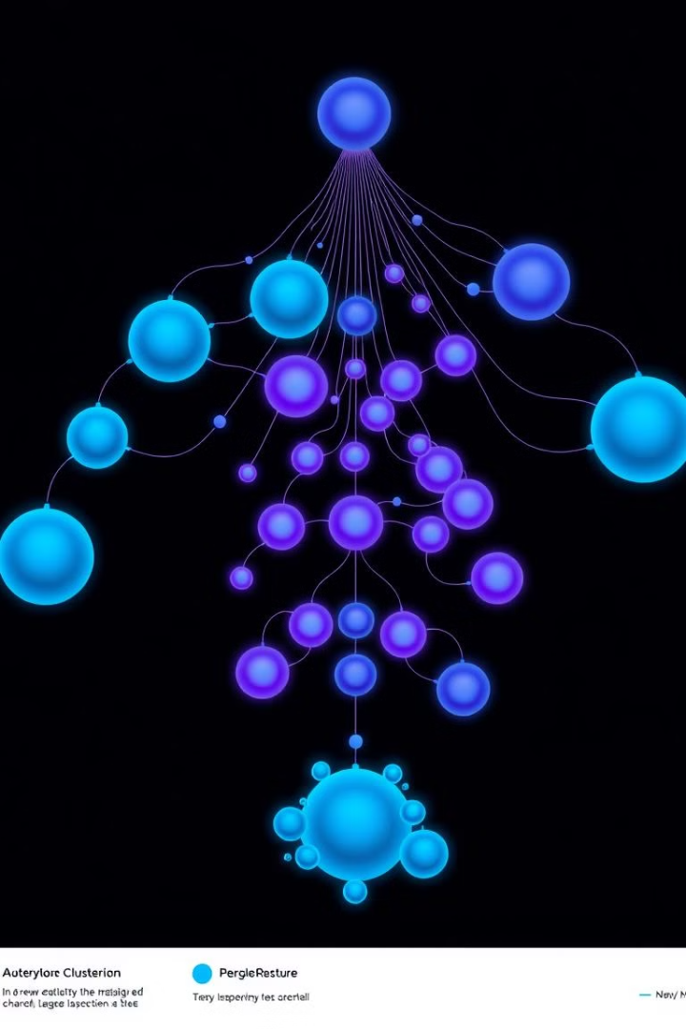
Introduction to Clustering Techniques
01
Definition of Clustering
Clustering is a machine learning technique that groups data points into clusters based on shared characteristics, helping to uncover patterns.
02
Objective of the Presentation
This Presentation compares K-Means, Hierarchical Clustering, and DBSCAN to identify the best clustering method for global development data.
03
Deployment of the Model
The analysis model was deployed using joblib, enabling the saved trained model for future predictions.
Page:1

Slide 4
Dataset Overview and Data Preprocessing Steps
Exploring key features and preprocessing techniques
Synthetic Dataset for Analysis
Life Expectancy (Years)
Utilizes a synthetic dataset simulating real-world global development scenarios.
A key indicator of health standards and overall quality of life in populations.
GDP per Capita (USD)
Handling Missing Values
Indicates economic strength and correlates with living standards and healthcare access.
Replaced missing entries with mean and median values to maintain data integrity.
Internet Usage (%)
Outlier Detection
Reflects technology adoption and digital connectivity, crucial for economic growth.
Used interquartile range (IQR) to identify and manage outliers within the dataset.
Population Age Distribution
Scaling Features
Important for analyzing dependency ratios and workforce availability in populations.
Applied StandardScaler to normalize feature ranges for equitable clustering.
Page:2

Slide 5
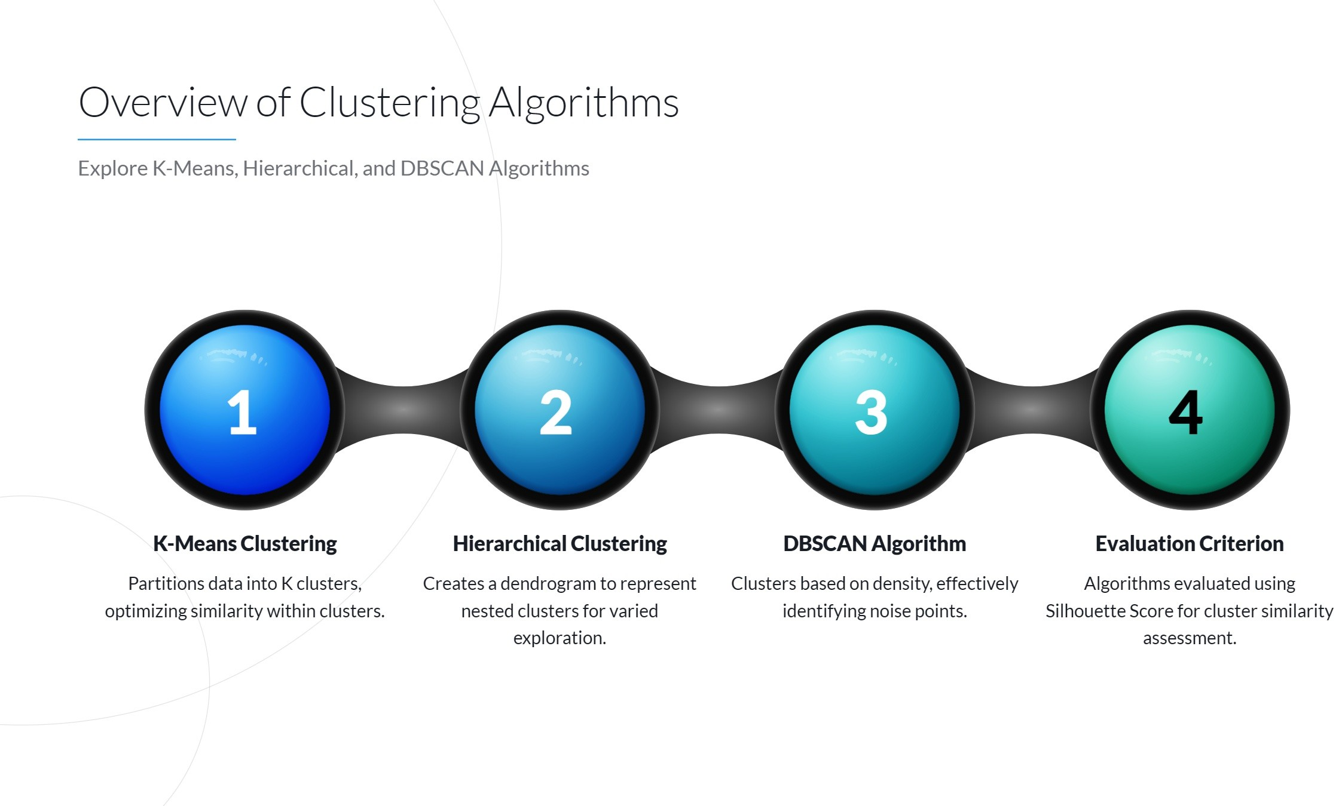
Overview of Clustering Algorithms
Explore K-Means, Hierarchical, and DBSCAN Algorithms
Page:3

Slide 6
EDA[Exploratory data analysis]
Exploratory Data Analysis (EDA) is like detective work for data! It’s the first step in uncovering hidden patterns, spotting outliers, and understanding the story behind the numbers. By combining creativity and analytical skills, EDA transforms raw data into meaningful insights, paving the way for impactful decision-making.
Understand the Data:
Load and explore the dataset to grasp its structure and contents.
Identify data types, missing values, and inconsistencies.
Summarize the Data:
Use descriptive statistics to measure central tendency (mean, median) and variability (range, standard deviation).
Visualize Patterns:
Create charts like histograms, scatterplots, and box plots to spot trends and relationships.
Handle Missing/Outlier Data:
Address gaps and outliers through imputation or transformation techniques.
Feature Engineering:
Derive new variables or transform existing ones for better analysis.
01
02
03
04
05
Page:4

Slide 7
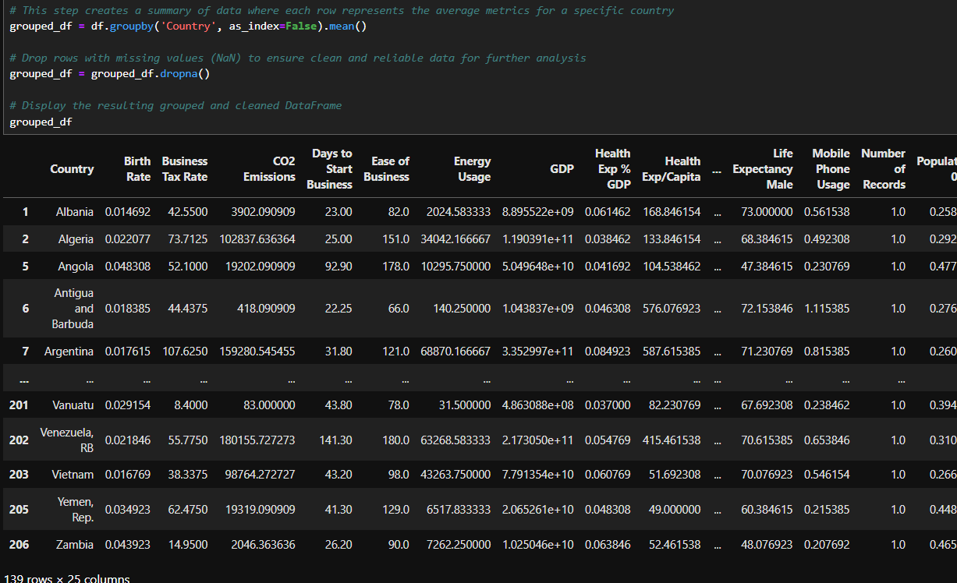
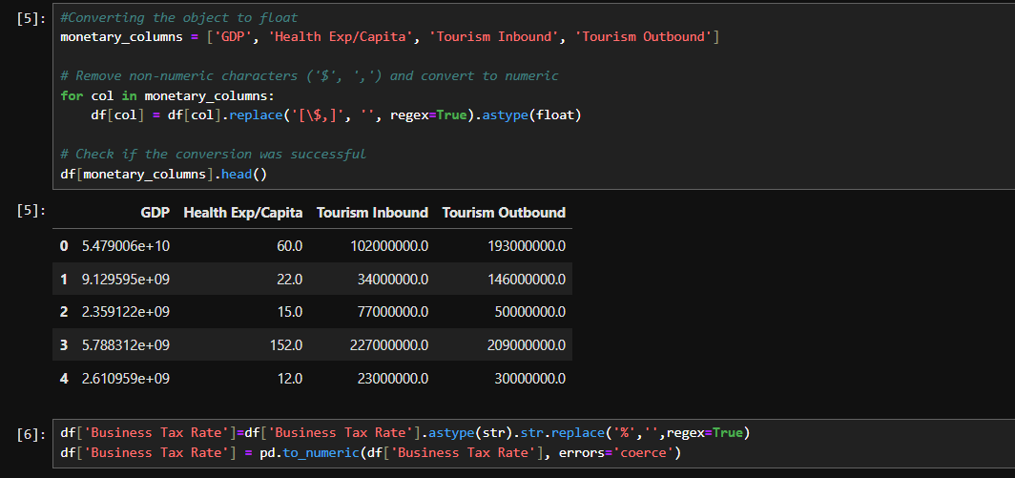
EDA
Page:5

Slide 8
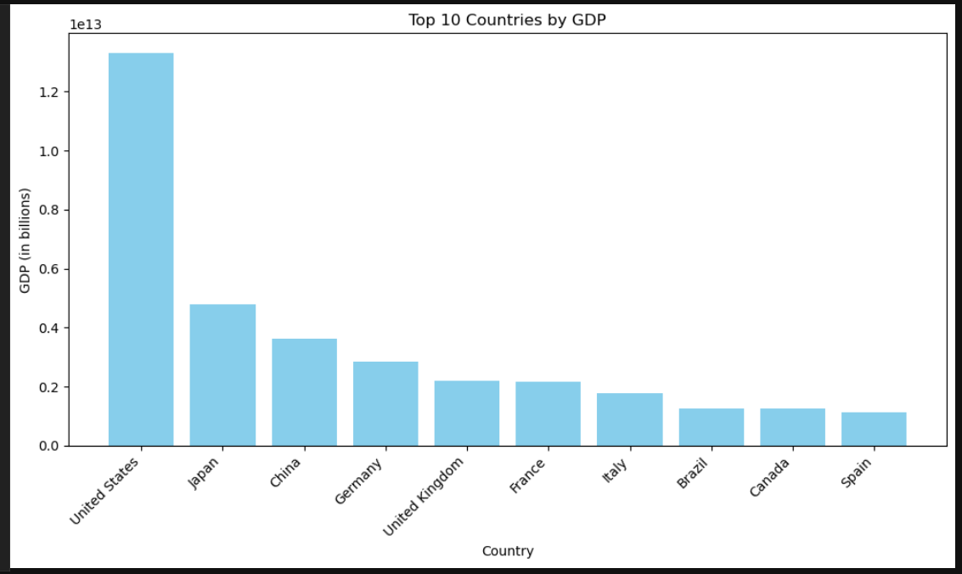
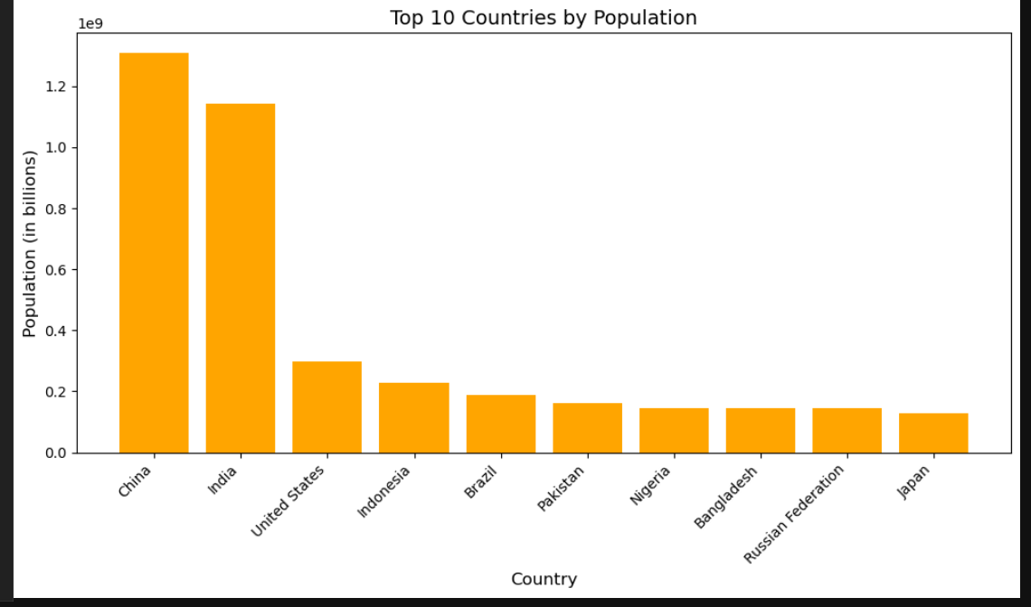
Top 10 countries by GDP and population
Page:6

Slide 9
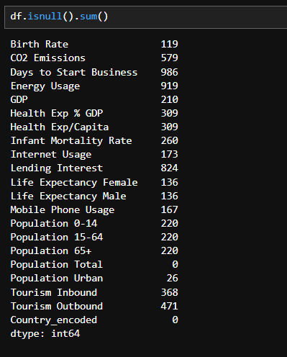
Handling Missing Values
Missing Data Overview:
Columns with the highest missing values:
Days to Start Business: 986 missing values.
Lending Interest: 824 missing values.
CO2 Emissions: 579 missing values.
Challenges of Missing Data:
Reduces data quality and affects analysis accuracy.
Impacts clustering and predictive model performance.
Strategies to Handle Missing Values:
Remove Rows/Columns: Drop data points with excessive missing values.
Imputation Techniques:
Replace with mean, median, or mode.
Use forward or backward filling.
Predict missing values using machine learning models.
Visualizing Missing Data:
Highlight patterns of missing values using heatmaps or bar charts.
Actionable Next Steps:
Decide on critical columns to retain based on missing value thresholds.
Apply suitable imputation techniques to minimize data loss.
01
02
03
04
05
06
Page:7

Slide 10
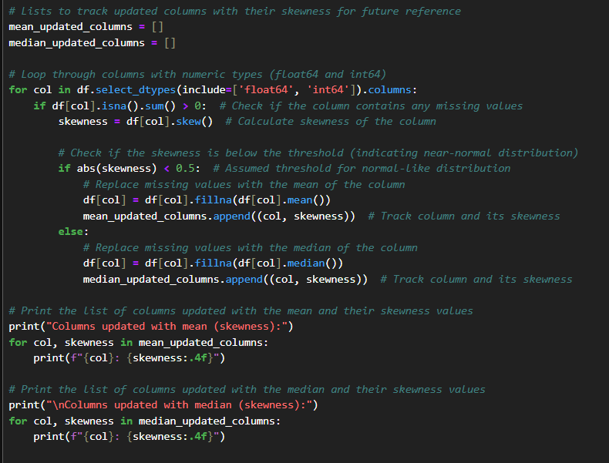
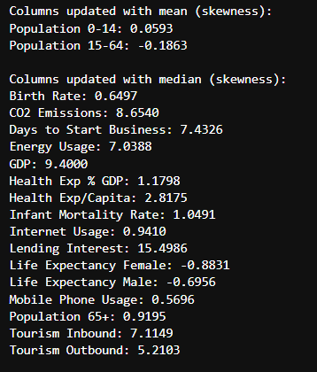
Skewness Of Data
01
Based on skewness of data ,we can replace missing values by mean(<0.5) and median.
Columns like GDP, CO2 Emissions, and Lending Interest have extremely high skewness, indicating significant outliers or uneven distributions.
Life Expectancy Female and Life Expectancy Male are negatively skewed but still not close enough to normal, so median imputation was used.
02
03
Page:8

Slide 11
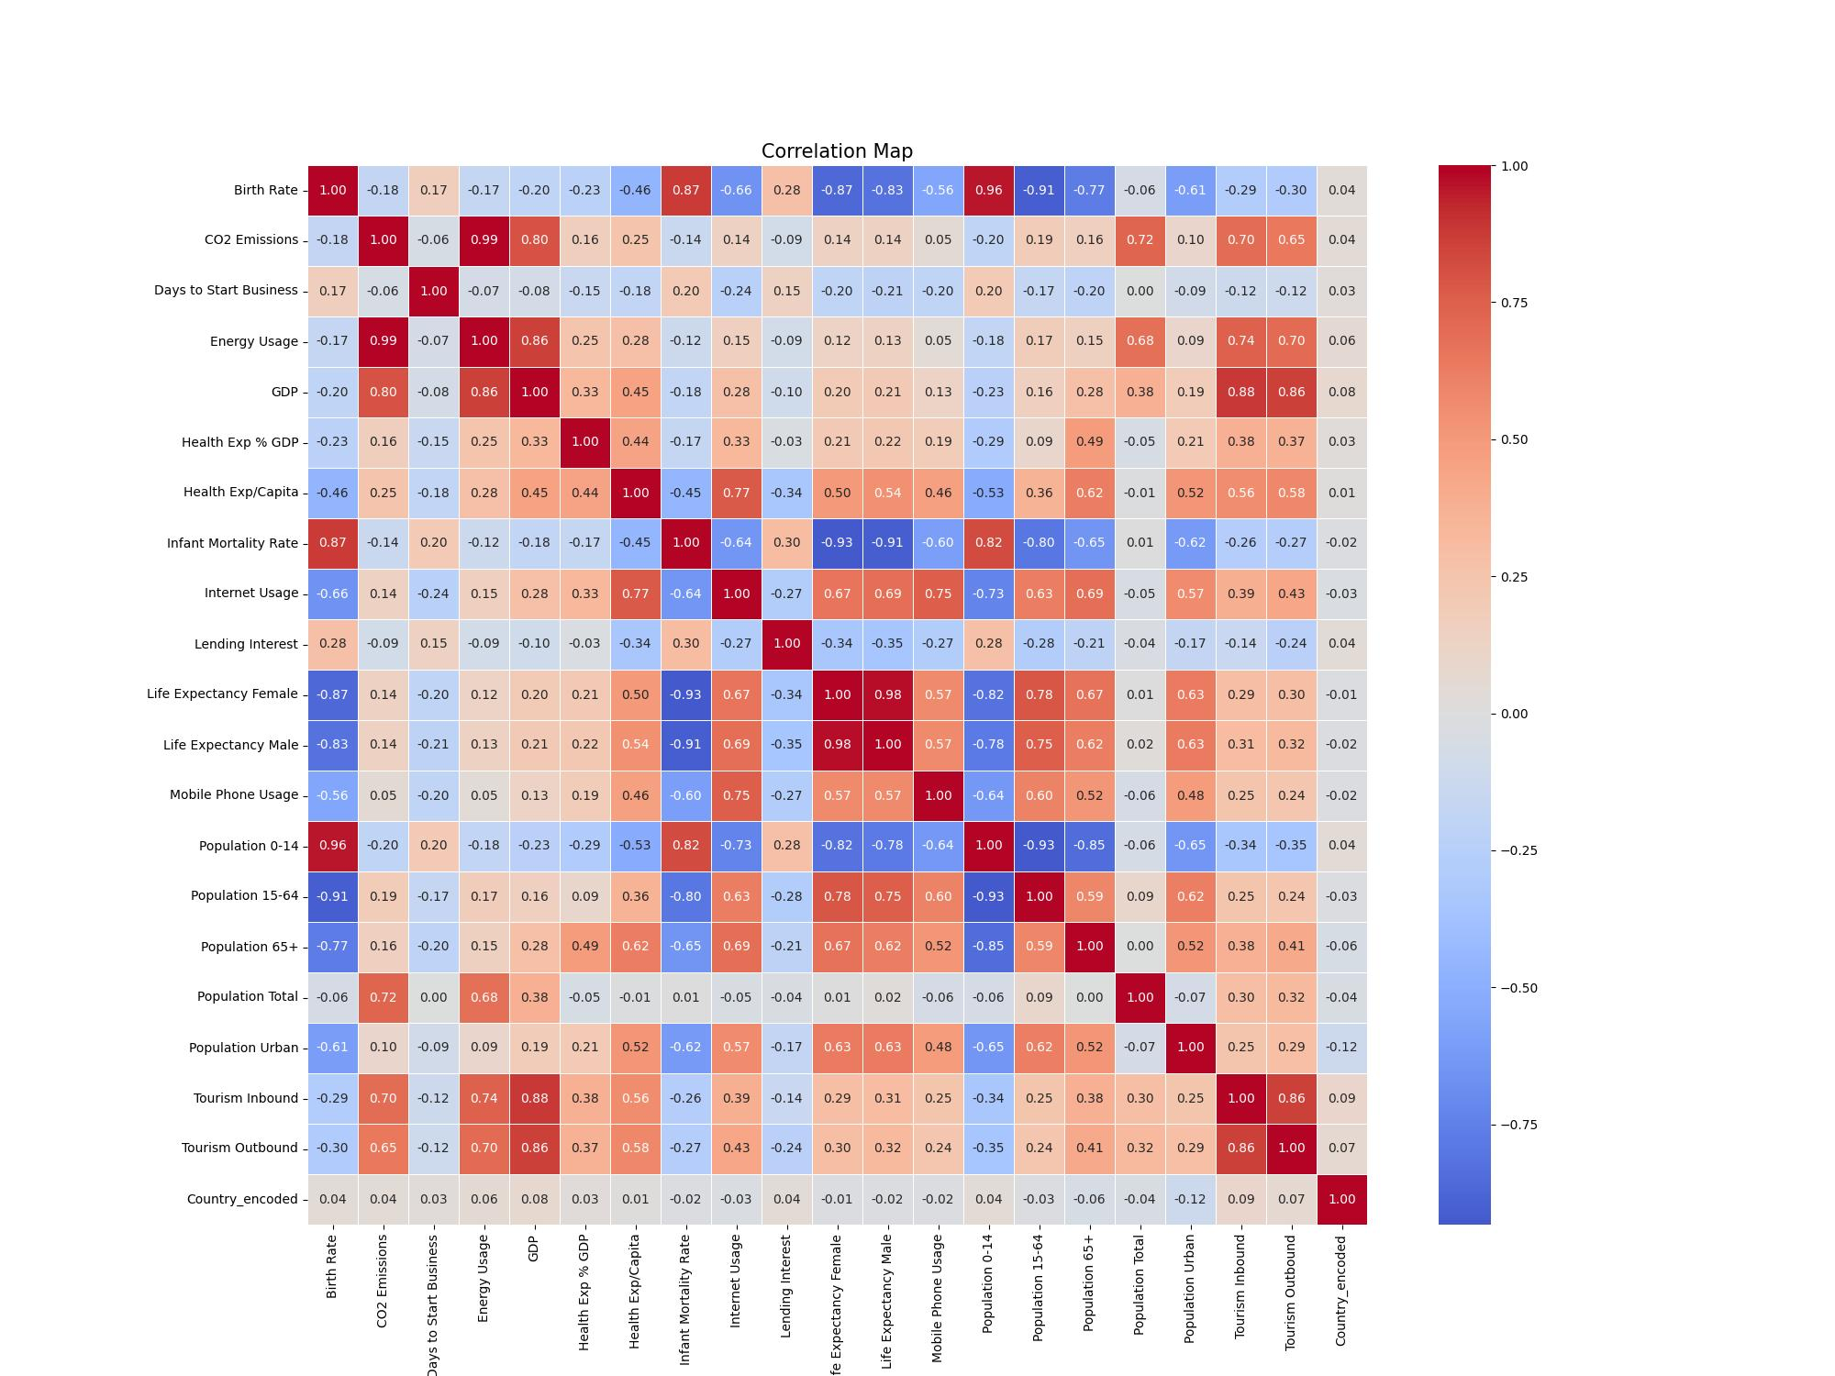
Correlation Matrix
Page:9

Slide 12
Key Observations from the Correlation Matrix:
Strong Positive Correlations:
GDP and Energy Usage (0.85):
Wealthier countries consume more energy due to industrialization.
Tourism Inbound and Outbound (0.86):
Higher inbound tourism is associated with higher outbound tourism.
Population 0-14 and Birth Rate (0.94):
Higher birth rates correlate with a larger proportion of the population in the 0-14 age group.
Life Expectancy Female and Male (0.98):
Life expectancy for both genders is highly correlated.
Energy Usage and GDP (0.85)
Higher economic activity is linked to higher energy consumption.
Strong Negative Correlations:
Birth Rate and Life Expectancy Female (-0.86): Higher birth rates tend to lower female life expectancy.
Population 0-14 and Population 15-64 (-0.90): Countries with more children (0-14) tend to have fewer working-age people.
Population 0-14 and Life Expectancy Female (-0.81): Higher birth rates correlate with lower female life expectancy.
Other Notable Correlations:
Health Expenditure % GDP and CO2 Emissions (0.14): Slight positive correlation, possibly due to industrialization.
Mobile Phone Usage and Internet Usage (0.74): Strong positive correlation, indicating higher mobile usage with more internet access.
Energy Usage and CO2 Emissions (0.91): Very strong positive correlation, as higher energy usage leads to more CO2 emissions.
Life Expectancy Female and Male (0.98): Life expectancy for both genders is almost perfectly correlated.
Page:10

Slide 13
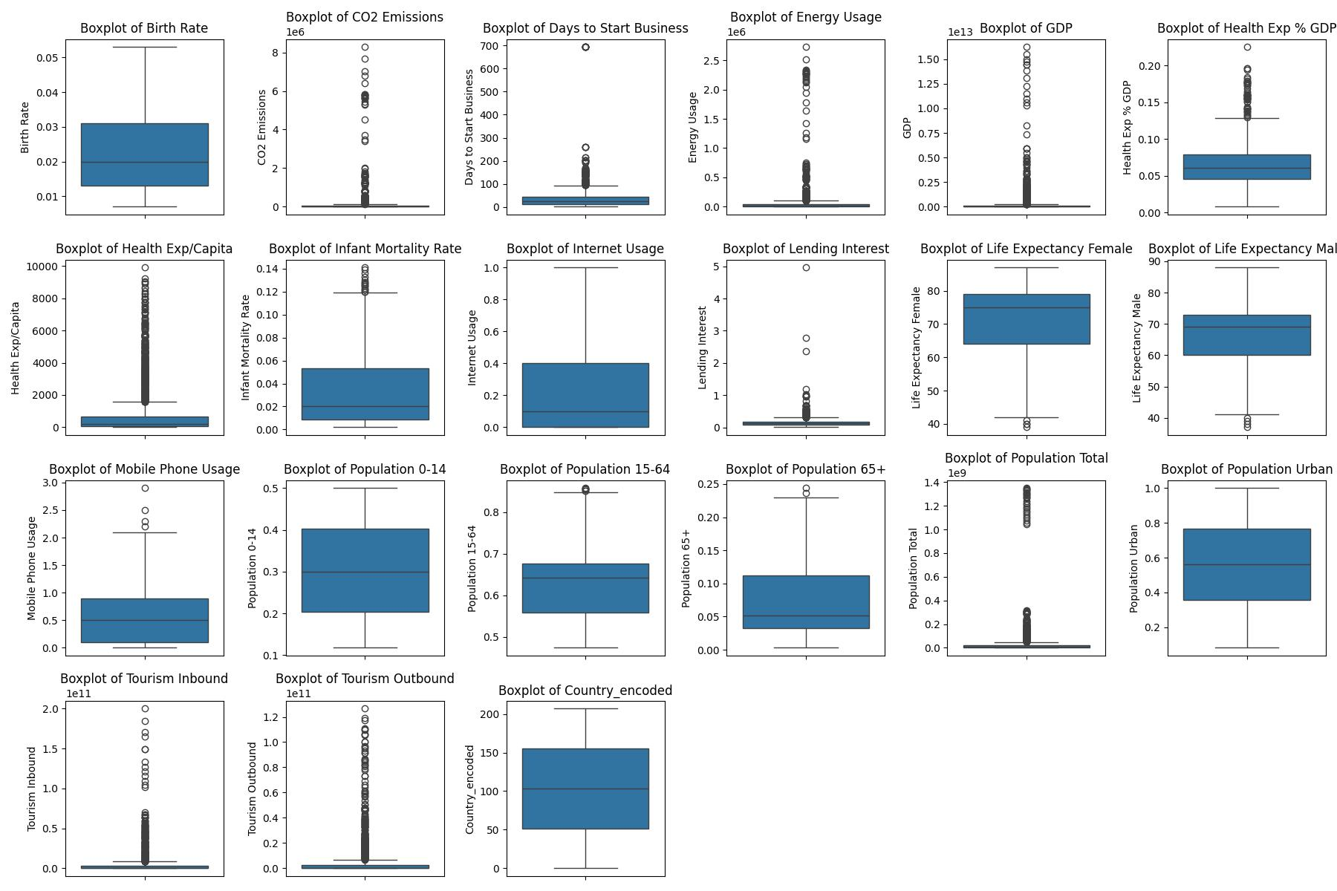
Outlier Detection
Page:11

Slide 14
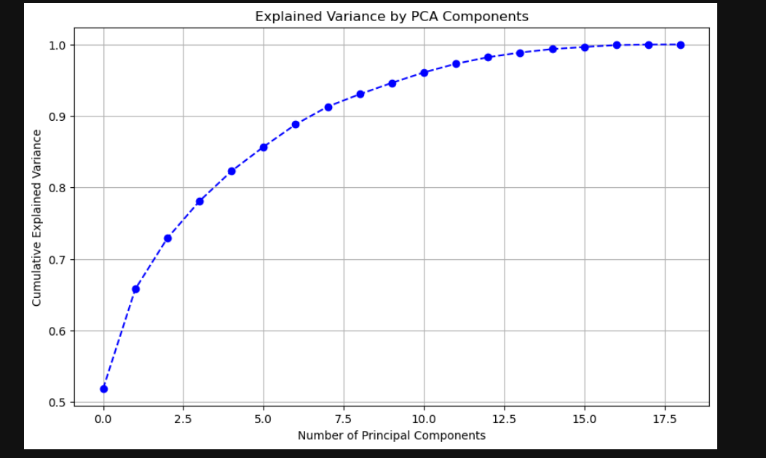
PCA[Principle component analysis]
Page:12

Slide 15
Preprocessing Techniques
Data was scaled to ensure feature normalization, essential for enhancing clustering performance.
Modelling Algorithms
Three algorithms (K-Means, Hierarchical Clustering, DBSCAN) were fitted to the preprocessed data for analysis.
Methodology & Visualization
Principal Component Analysis
PCA was utilized to reduce dimensionality, making the visualization of clusters more accessible.
Overview of Data Preprocessing and Visualization Techniques
Visualization Insights
Plots display distinct clusters formed by each algorithm, highlighting their strengths and weaknesses.
Page:13

Slide 16
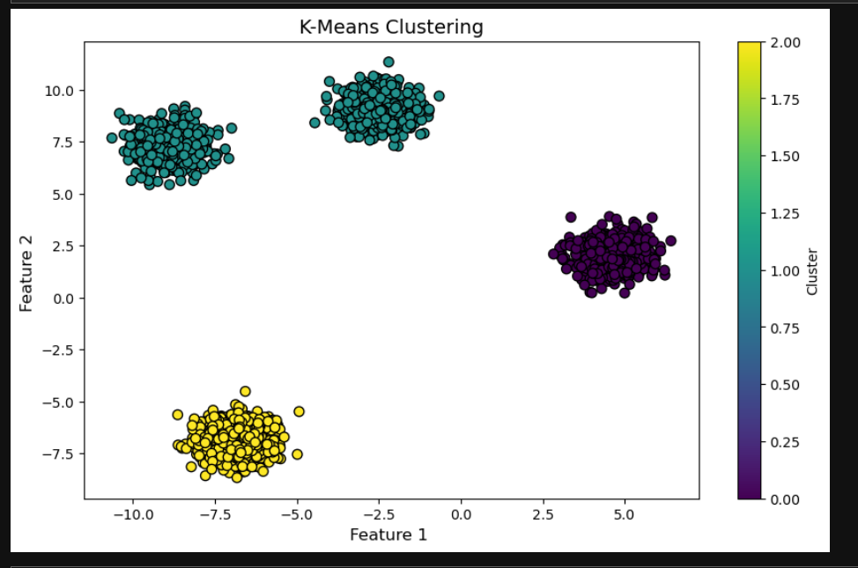
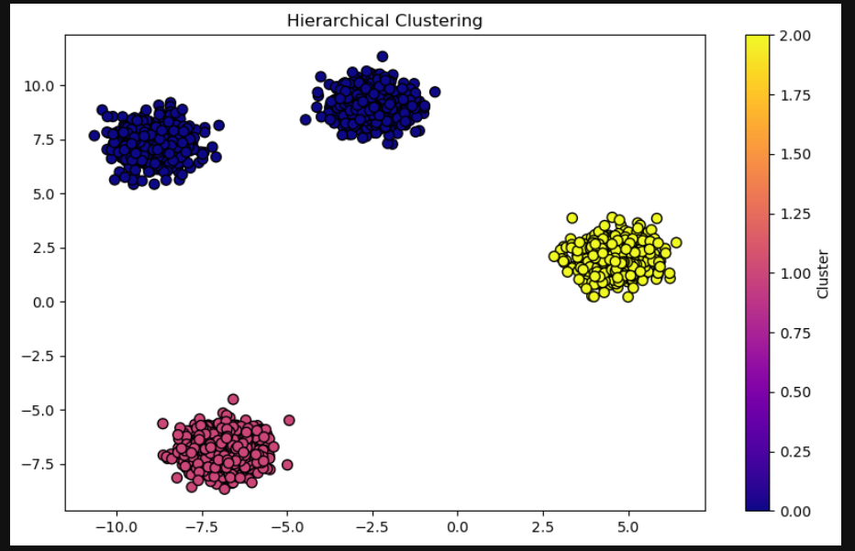
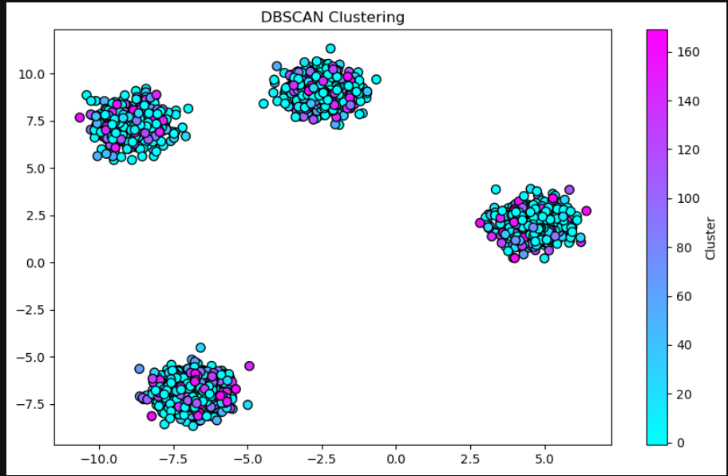
Visualization of Clustering Results
Comparative analysis of clustering effectiveness
K-Means
Hierarchical
DBSCAN
Page:14

Slide 17
Silhouette Scores Analysis
0.7953
0.7953
K-Means
Hierarchical
Indicates the highest separation between clusters.
Slightly lower separation, but still performs well.
-0.5975
DBSCAN
Indicates poor clustering due to noise and challenges with the chosen parameters.
Page:15

Slide 18




Deployment and Model Deployment Strategies
Model Selection
Based on silhouette scores, K-Means emerges as the most suitable algorithm.
Model Training
The chosen K-Means model is trained on the dataset to learn cluster patterns.
Model Saving
Using joblib, the trained K-Means model is saved for future use.
Model Loading
The saved K-Means model is loaded for deployment in new applications.
Page:16

Slide 19
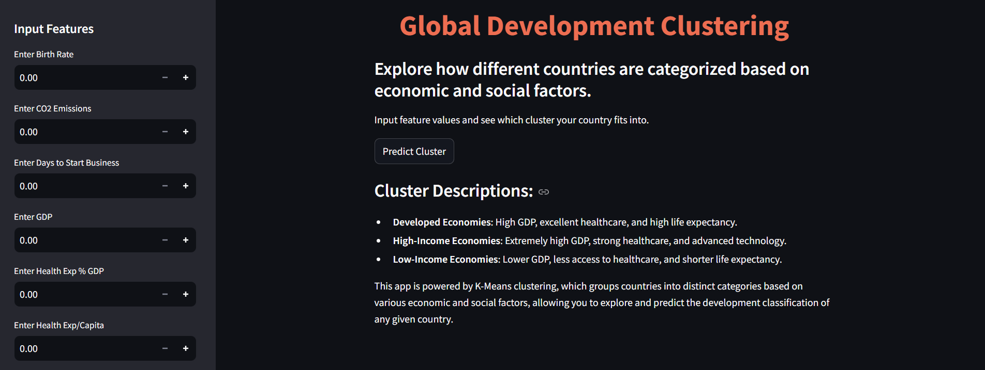
Deployment
Fig : Stream Lit Dashboard
Page:17

Slide 20
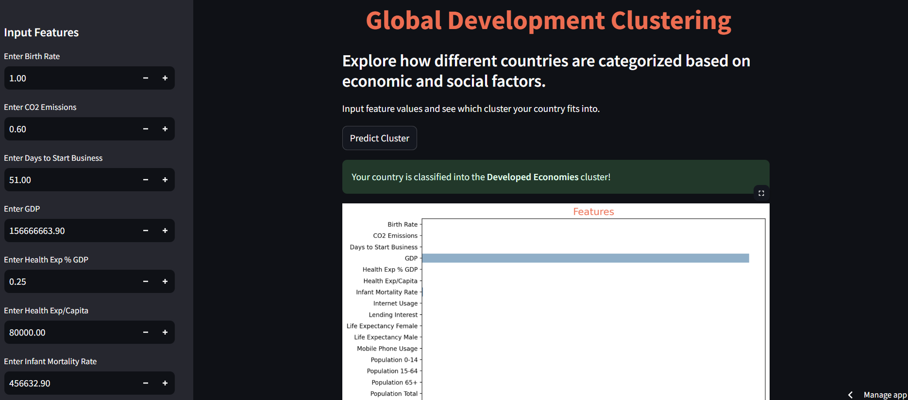
Deployment
Fig : Prediction Page
Page:18

Slide 21
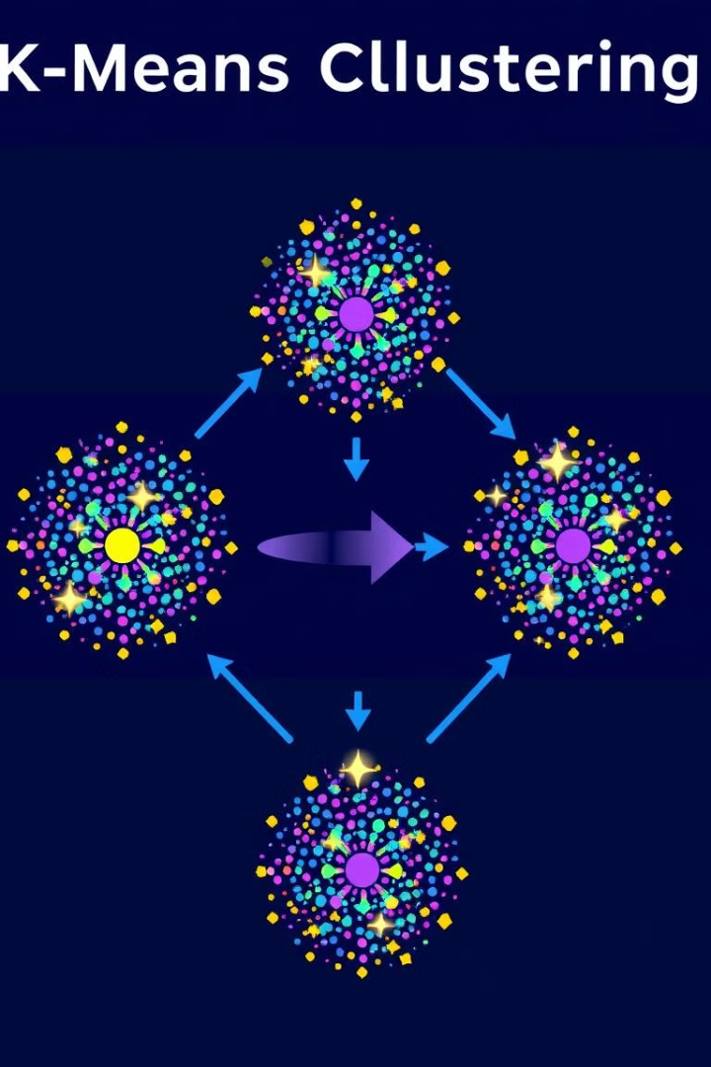
Conclusion
This presentation provided a comprehensive overview of clustering algorithms, emphasizing the importance of choosing the right algorithm based on data characteristics and desired outcomes. Silhouette scores proved valuable in evaluating cluster quality. K-Means emerged as a robust option, demonstrating its potential in diverse applications. Joblib's deployment strategies ensure model reusability and efficient integration into new projects.
Page:19

Slide 22


Thank you

